Slide 1

Lecture 2: Linear regression, Gradient descent and Supervised learning theory
Assaf Shocher
assafshocher@gmail.com

Slide 2
Overview
Linear regression continued
Gradient Descent
Reminder: Types of machine learning
Linear regression as a supervised learning example
Supervised learning theory: Model
What is the error made of?
Overfitting and regularization
Regularized linear regression
Recommend resources:
Shai Shalev-Shwartz: Understanding Machine Learning: From Theory to Algorithms
Andrew NG: CS229 Lecture notes

Slide 3
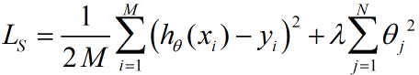
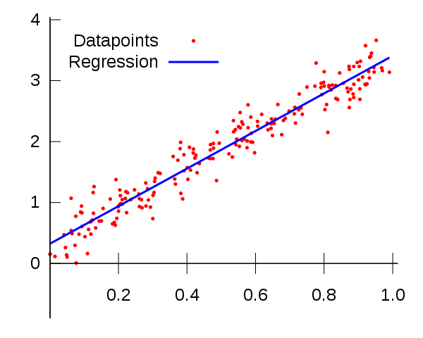
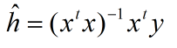
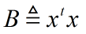
Reminder: linear regression
What does it mean if not invertible?

Slide 4
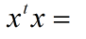
What does it mean if B is not invertible?
Mathematically: columns of X are linearly dependent. (note: B is a correlation matrix).
In practice: X has redundant features i.e. at least one feature can be concluded out of the other features and therefore does not provide any new information.
Example:
Consider following features:
Age driving license received
Years driving
Current age
17 | 4 | 21
19 | 15 | 34
22 | 22 | 44
18 | 52 | 70
1458 | 1773 | 3231
1773 | 3429 | 5202
3231 | 5202 | 8433
x=
+

Slide 5
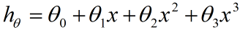
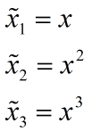
Can be used for more complex features
This is still a linear regression.
The features are now the exponents of x:

Slide 6
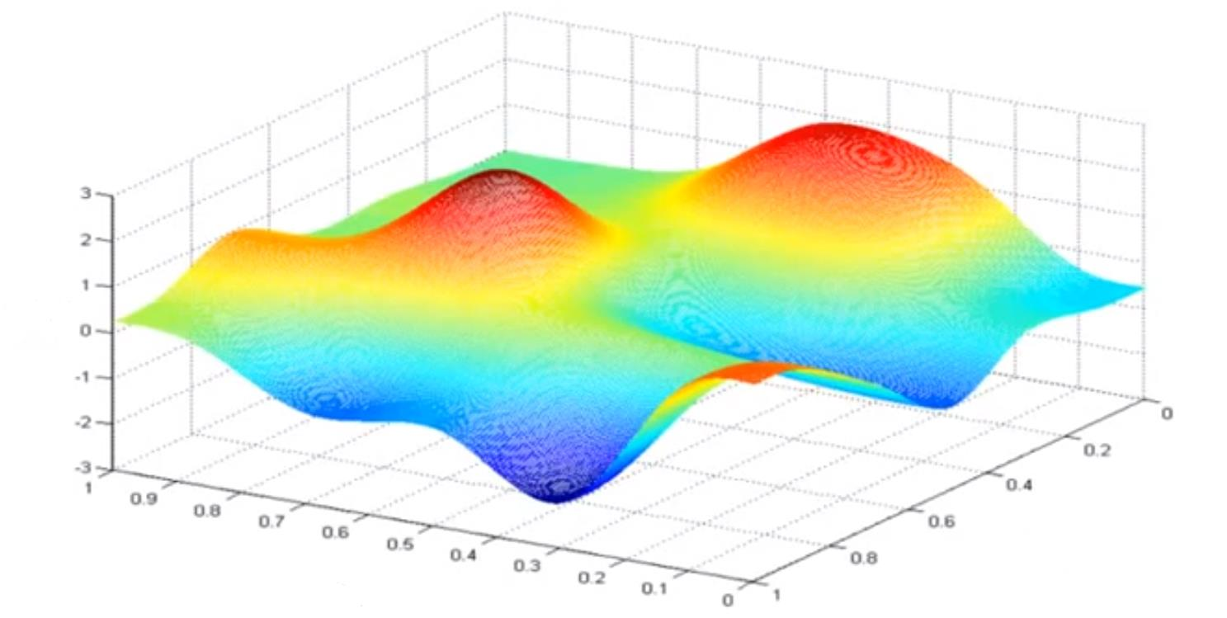
Weight space
L
W2
W1

Slide 7
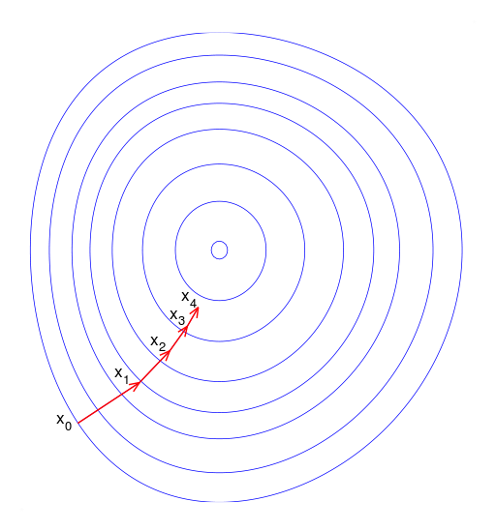
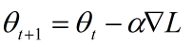
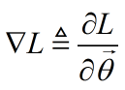
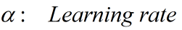
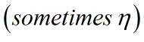
Gradient descent
Repeat until convergence:
where:

Slide 8


Slide 9
Gradient descent problems
Computation time: Run over all training set each step
“Hop” over target
Plateau / Saddle point
Convergence too slow
Local minima

Slide 10
Gradient descent types
Batch gradient descent
Incremental gradient descent
Stochastic gradient descent
Mini-batch gradient descent

Slide 11
Gradient descent problems
Computation time: Run over all training set each step solved :)
“Hop” over target
Plateau / Saddle point
Convergence too slow
Local minima

Slide 12
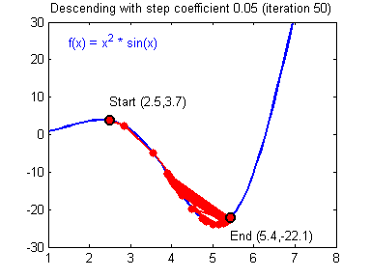
The significance of the learning rate
Solutions:
Choose wisely
Decaying learning rate
Adaptive learning rate methods
Differential learning rate methods

Slide 13
Gradient descent problems
Computation time: Run over all training set each step solved :)
“Hop” over target sort of solved :|
Convergence too slow
Plateau / Saddle point
Local minima

Slide 14
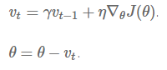
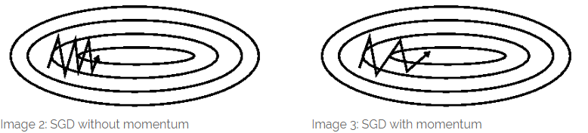
Gradient descent optimization techniques
Momentum

Slide 15
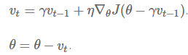
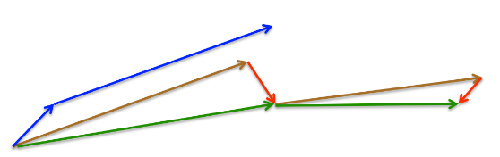
Gradient descent optimization techniques
Nesterov accelerated gradient

Slide 16
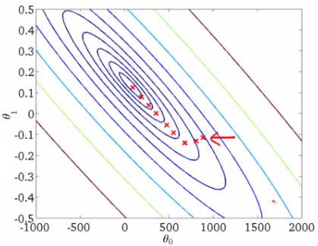
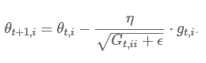
Adagrad and Adadelta

Slide 17


Slide 18
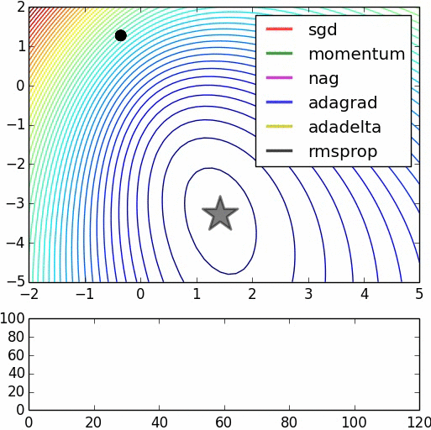

Slide 19


Slide 20

So which one to choose?

Slide 21
Gradient descent problems
Computation time: Run over all training set each step solved :)
“Hop” over target solved :)
Plateau / Saddle point sort of solved :|
Convergence too slow solved :)
Local minima unsolved :(

Slide 22
Reminder: types of machine learning
Supervised learning
Unsupervised learning
Reinforcement learning

Slide 23
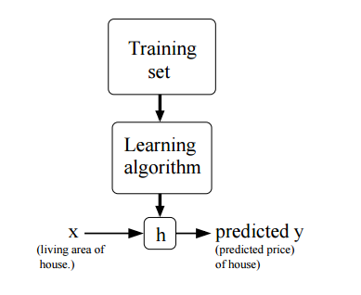
Supervised Learning Model
Training input: x_i
Terms of the vec x are called “features”
Training labels: y_i
Hypothesis: h(x) = y
Hypothesis class: H = {h_1, h_2 … }
Cost / Loss / Risk: L
Learning algorithm: A(X,Y) = h
Empirical risk and true risk: L_d, L_s

Slide 24

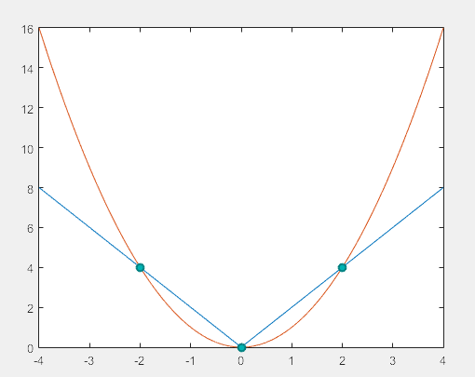
Why do we always want more data?
X = {-2, 0, 2}, Y = {4, 0, 4}.
H = {h_1, h_2 }
h_1 = 2|x|
h_2 = x^2

Slide 25
Hypothesis class examples
X = {-2, 0, 2}, Y = {4, 0, 4}.
Finite class:
{h_1 = 2|x|, h_2 = x^2}

Slide 26
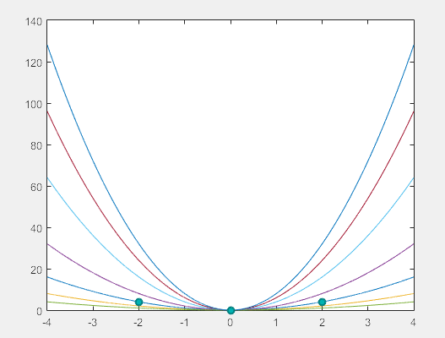
Hypothesis class examples
X = {-2, 0, 2}, Y = {4, 0, 4}.
Infinite class:
h_a = ax^2

Slide 27
What is the error made of?
What would you prefer, a big hypothesis class or a small one?

Slide 28
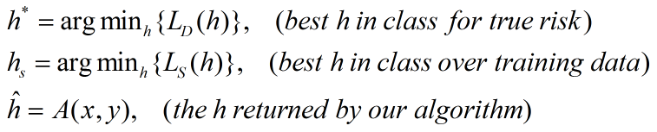
Special hypotheses

Slide 29
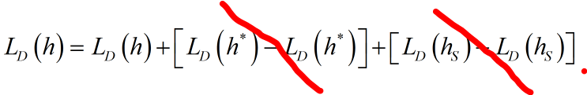
What is the error made of?

Slide 30
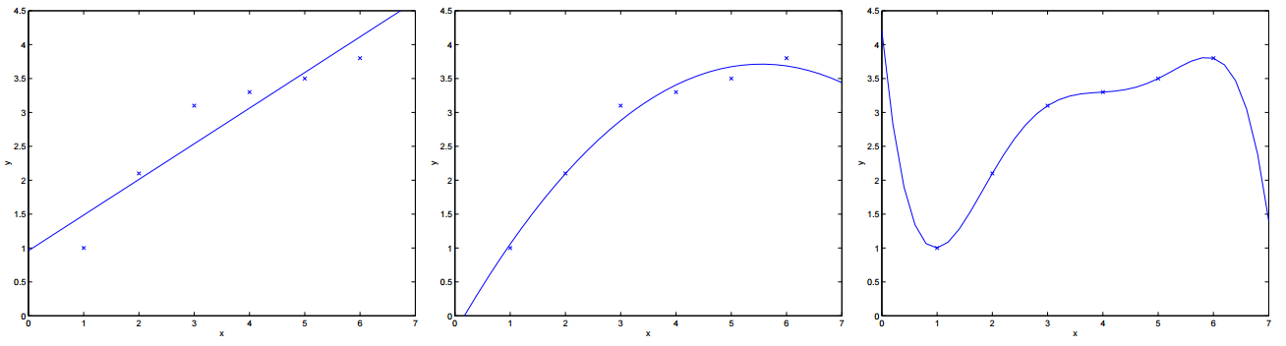
Overfitting

Slide 31
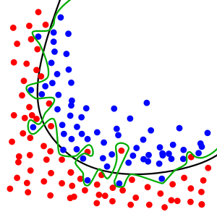

Why is overfitting so bad?
Too loyal to training set, poorly predicts unseen data.
Responses strongly to noise.
Metaphorically, overfitting is “memorizing” instead of “learning”.

Slide 32
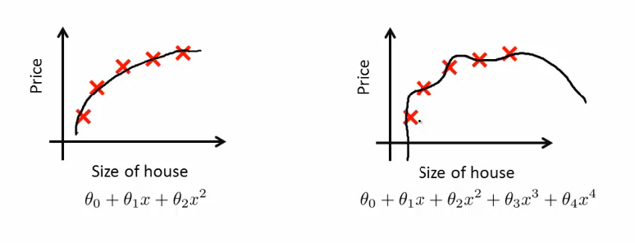
Solutions
Reduce number of features
Regularization

Slide 33
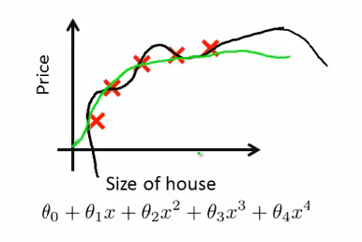
Regularization with the loss function

Slide 34
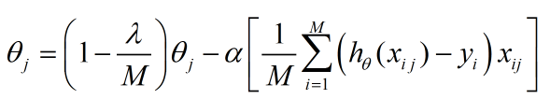
Regularized linear regression
By taking gradient of the new loss function:
Gradient descent is the same, only weights are all shrinking now!

